Slide 1
Graph Neural Networks
Spatial-based Graph Convolutional Networks
Guangzhi Zhao 1901110057

Slide 2
Spatial GCN
Neighborhood sampling
GraphSAGE
FastGCN
StoGCN
CNN architecture
PATCHY-SAN
LGCN
Expressive power
GIN
Modular GCN
Deep GCN
Why not deep
How to deep

Slide 3
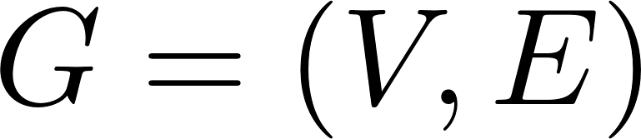
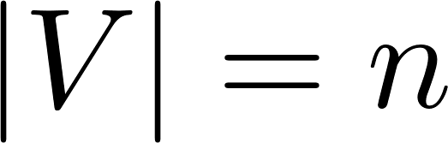
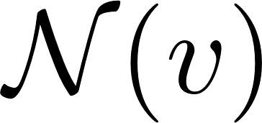
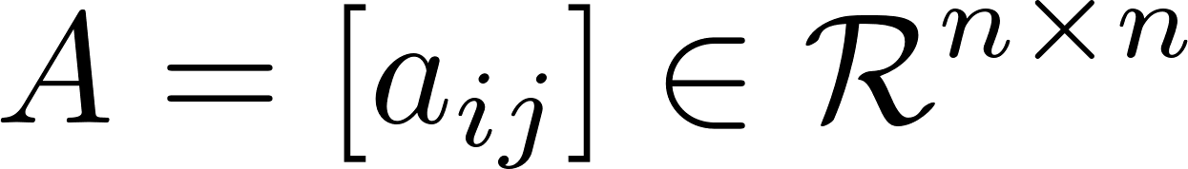
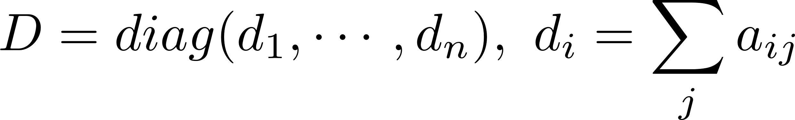
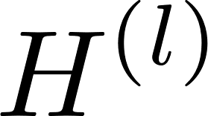
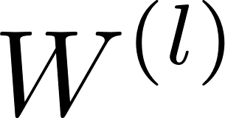
Notation
Graph:
Neighbors:
Adjacency matrix:
Degree matrix:
Feature matrix:
Hidden representation:
Weight:

Slide 4
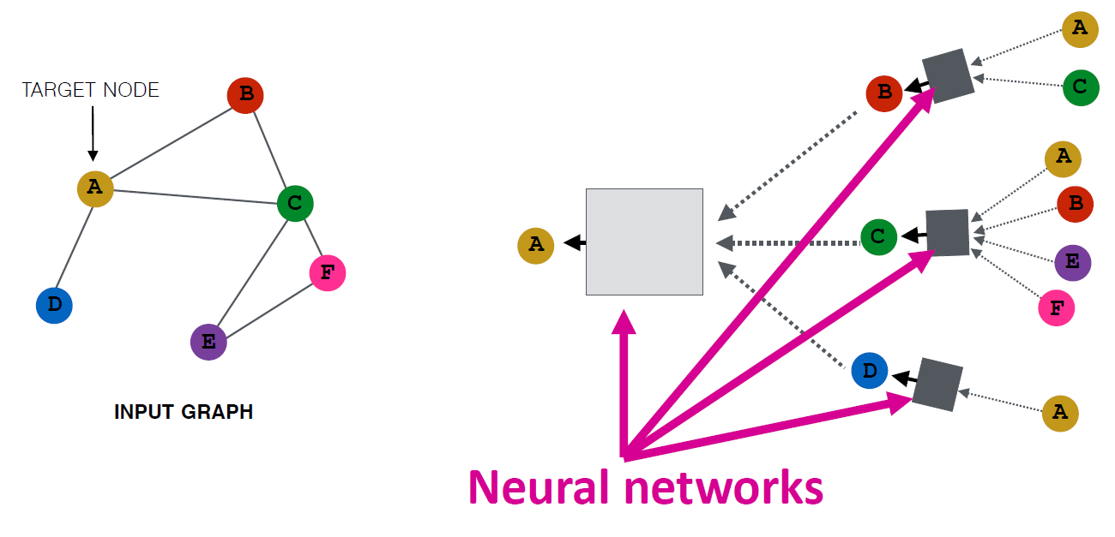
Spatial GCN
Intuition:Nodes aggregate information from their neighbors using neural networks

Slide 5
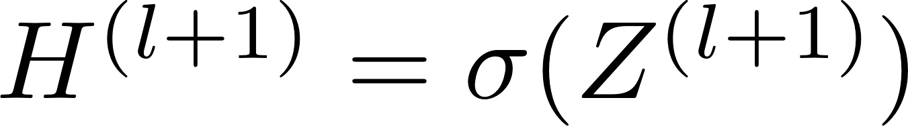
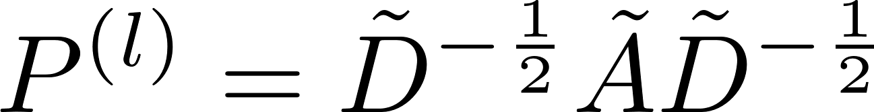
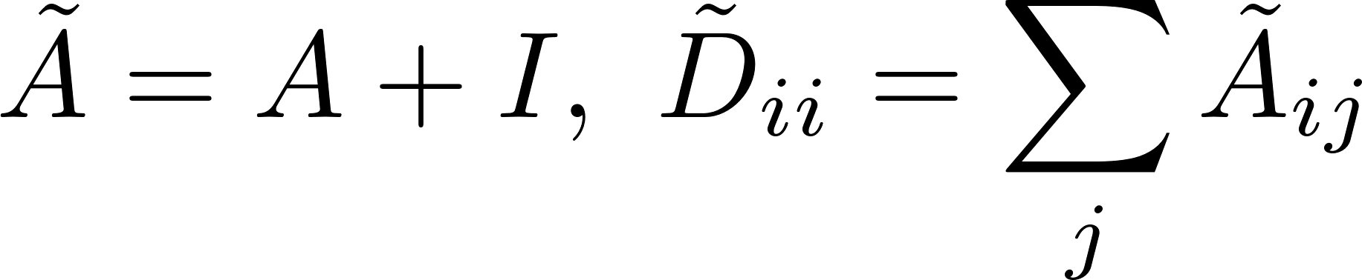
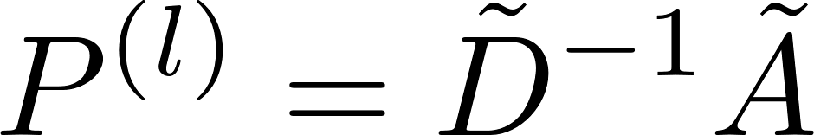
GCN
where ,with
Problems:
Transductive
Exponential increase

Slide 6
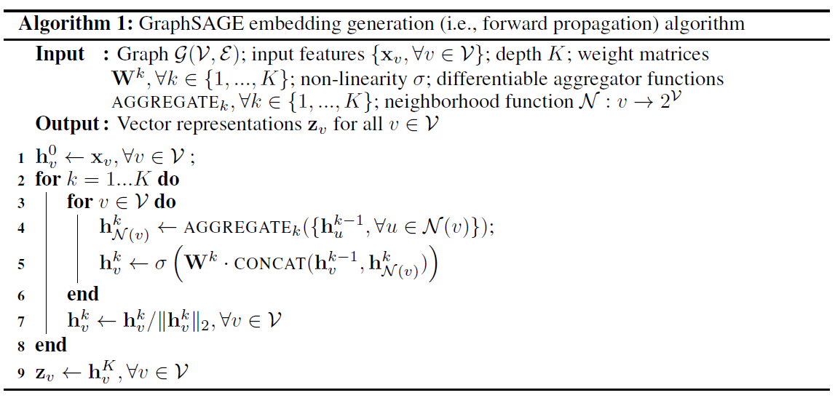
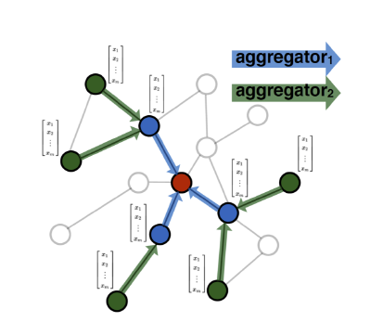
GraphSAGE(SAmple and aggreGatE)
W. Hamilton, Z. Ying, and J. Leskovec, “Inductive representation learning on large graphs,” in NeurIPS, 2017.

Slide 7
Aggregator
Mean
modified mean-based aggregator convolutional
Mean-based aggregator
LSTM
Apply LSTMs to a random permutation of the node's neighbors
Pooling

Slide 8

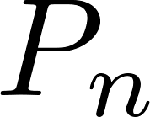
Learning
Supervised learning
Unsupervised learning (random walk)
where v is a node that co-occurs near u on fixed-length random walk, is the sigmoid function, is a negative sampling distribution, and Q defines the number of negative samples.

Slide 9
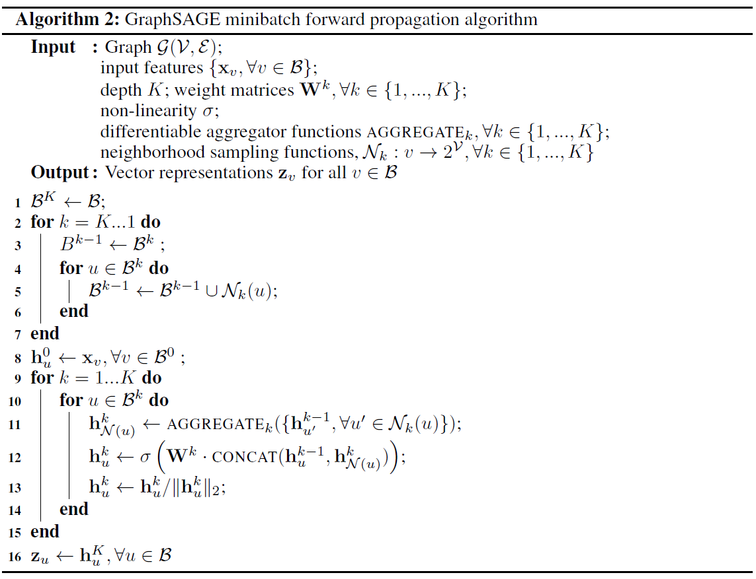
Minibatch

Slide 10
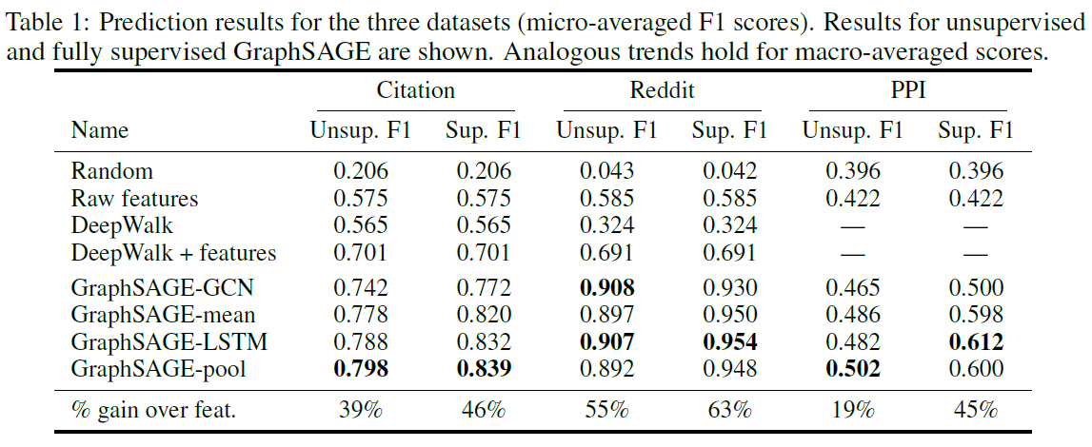
Experiments

Slide 11
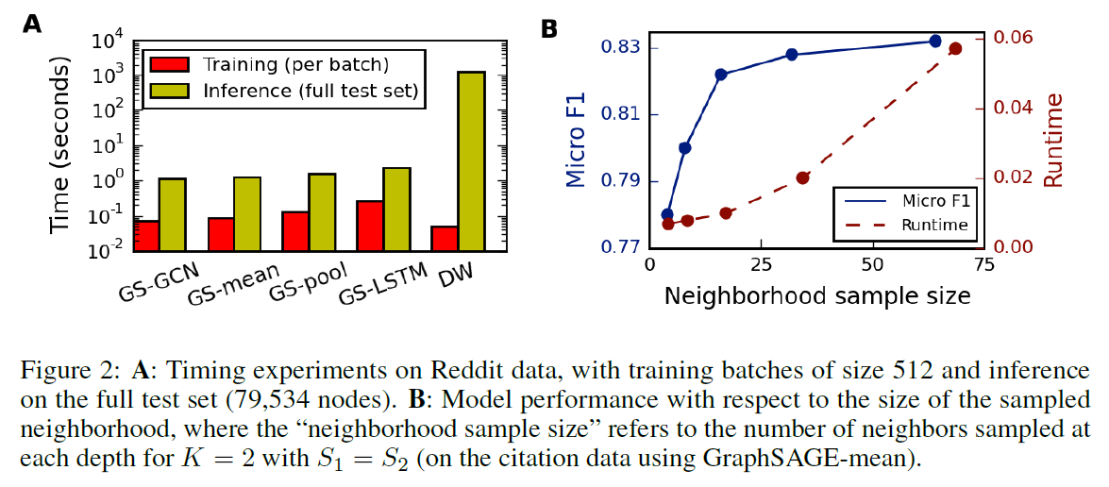
Experiments

Slide 12
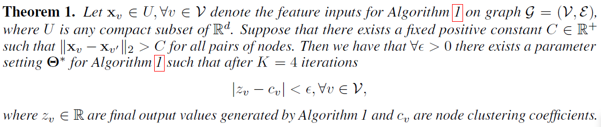
Expressive capability
Clustering coefficient means the proportion of triangles that are closed within the node's 1-hop neighborhood.
Theorem 1 states that for any graph there exists a parameter setting for Algorithm 1 such that it can approximate clustering coefficients in that graph to an arbitrary precision, if the features for every node are distinct.

Slide 13
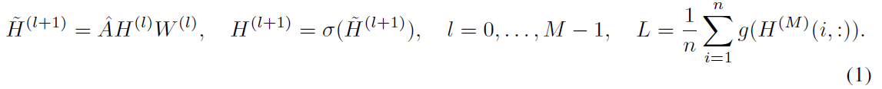
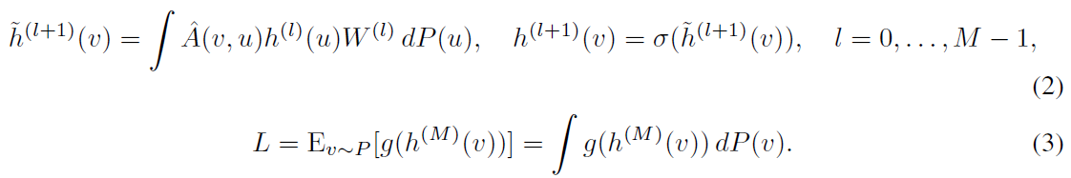
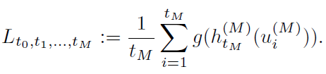
FastGCN
Functional generalization
Monte Carlo
J. Chen, T. Ma, and C. Xiao, “Fastgcn: fast learning with graph convolutional networks via importance sampling,” in Proceedings of the 7th International Conference on Learning Representations, 2018.

Slide 14
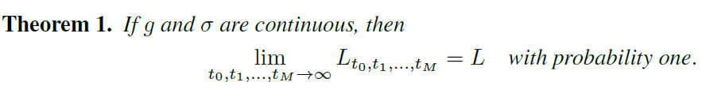
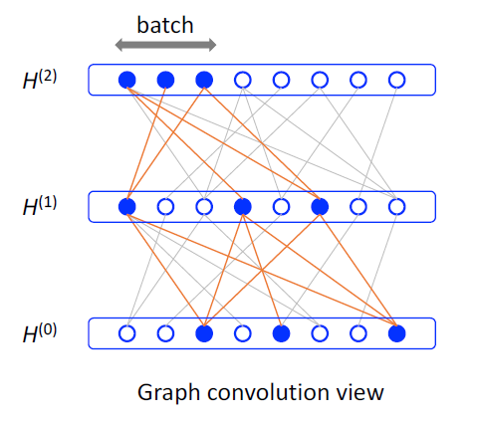
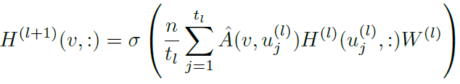
FastGCN

Slide 15
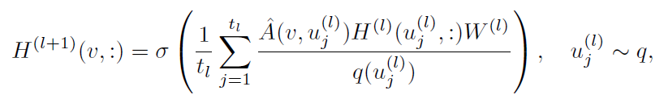
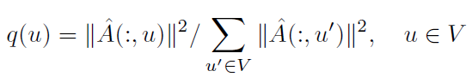
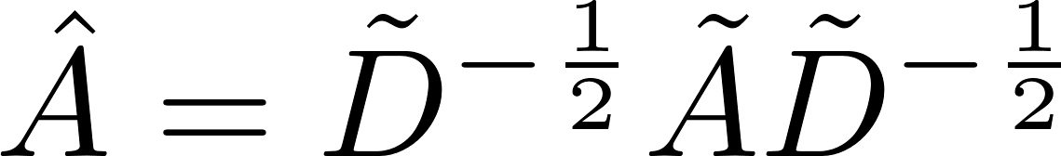
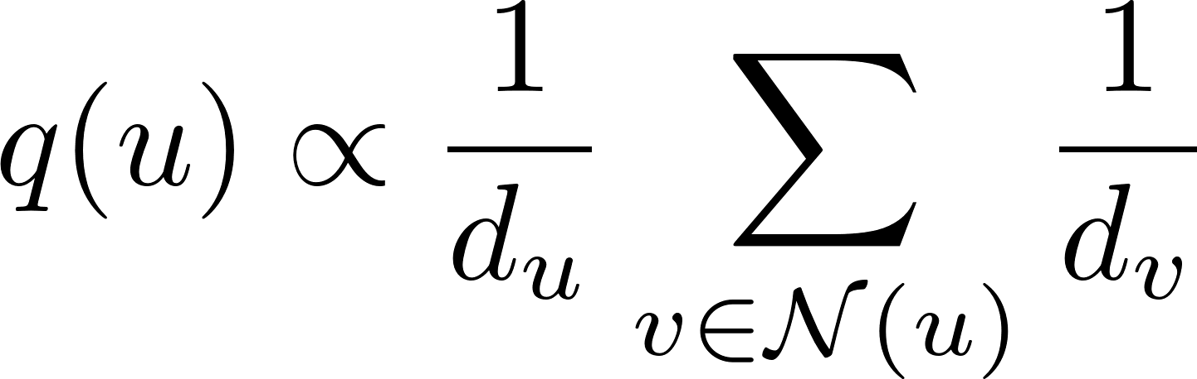
Importance sampling
Probability mass function:
If then

Slide 16
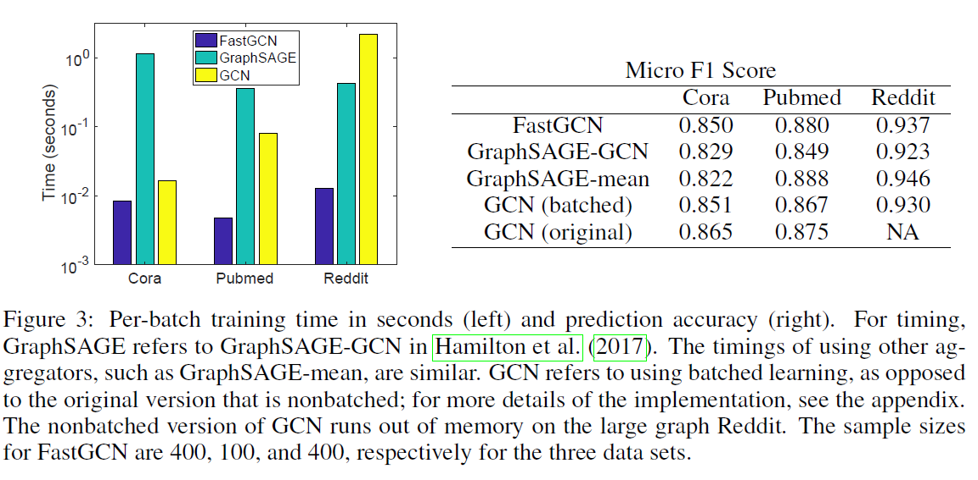
Experiments

Slide 17
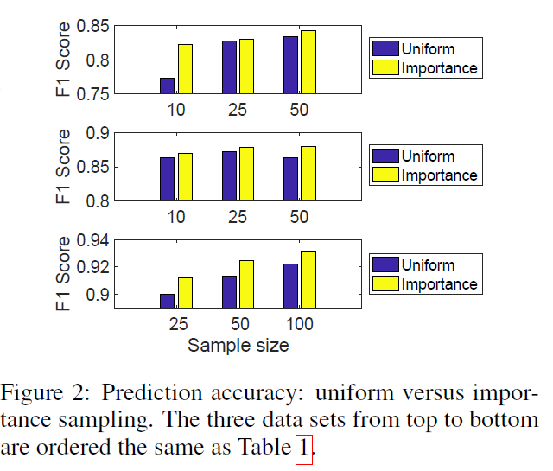
Experiments

Slide 18
StoGCN
GCN：Can’t handle large-scale dataset
GraphSAGE(NS):Exponential increase
FastGCN(IS):Can select no neighbor for one node
J. Chen, J. Zhu, and L. Song, “Stochastic training of graph convolutional networks with variance reduction,” in International Conference on Machine Learning, 2018.

Slide 19
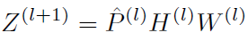
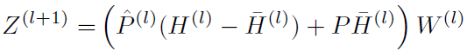
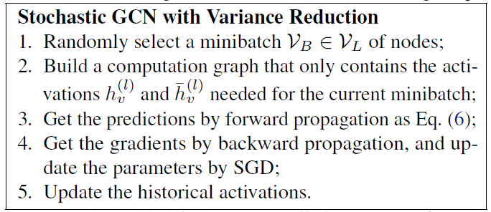
Control variate based estimator
NS:
CV:

Slide 20
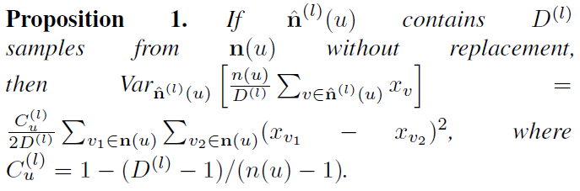
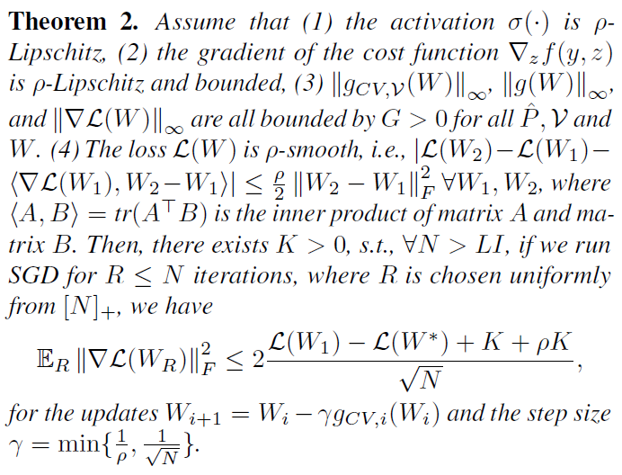
Variance analysis

Slide 21
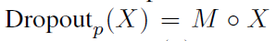
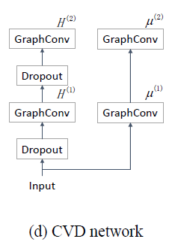
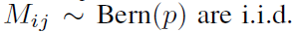
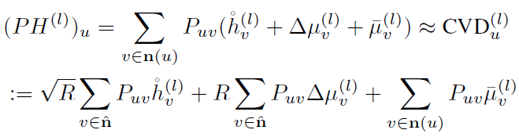
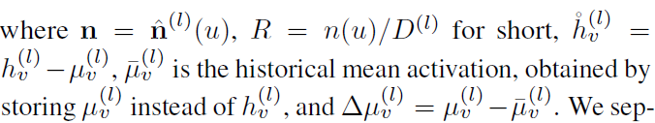

Control variate for dropout

Slide 22
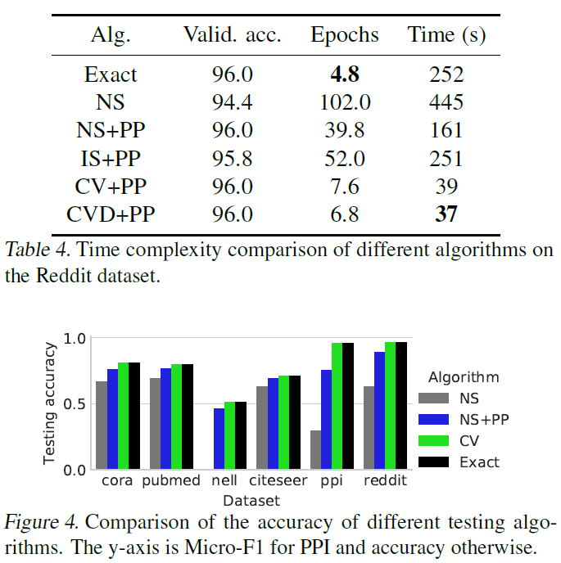
Experiments

Slide 23
PATCHY-SAN(Select-Assemble-Normalize)
Task: Graph classification
Idea: Choose fixed number of neighbors and give an order
M. Niepert, M. Ahmed, and K. Kutzkov, “Learning convolutional neural networks for graphs,” in International Conference on Machine Learning, 2016.

Slide 24
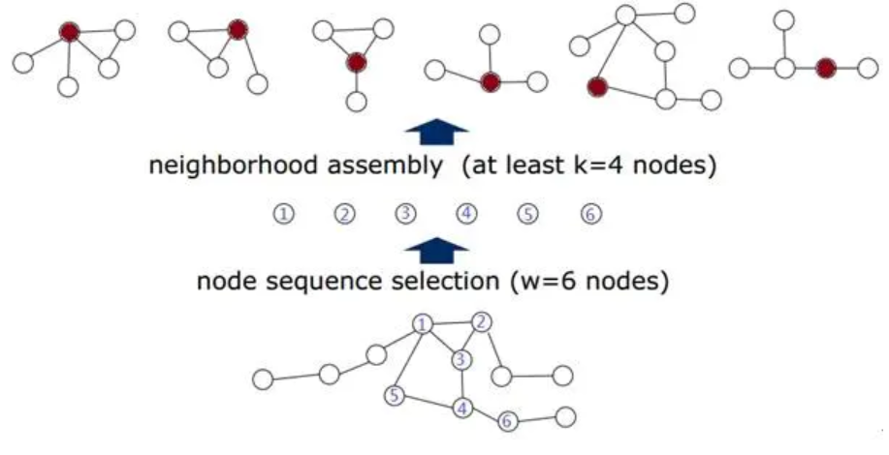
PATCHY-SAN
A given graph labeling

Slide 25
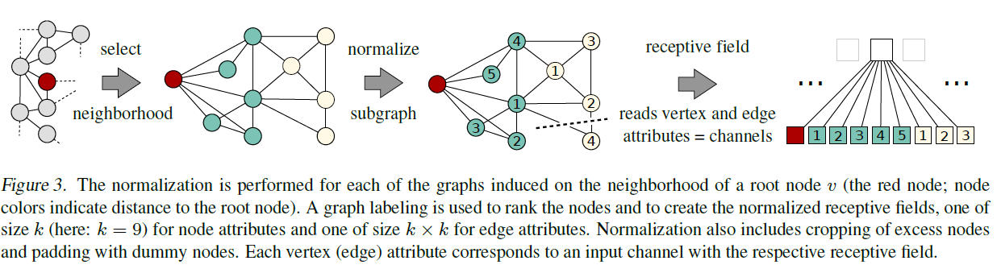
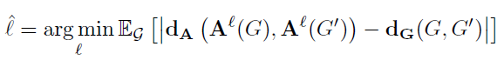
PATCHY-SAN
NAUTY

Slide 26
LGCN
GCN: No trainable parameter in aggregator
GAT: Related to node feature
H. Gao, Z. Wang, and S. Ji, “Large-scale learnable graph convolutional networks,” in Proceedings of the 24th ACM SIGKDD International Conference on Knowledge Discovery &amp; Data Mining, 2018.

Slide 27
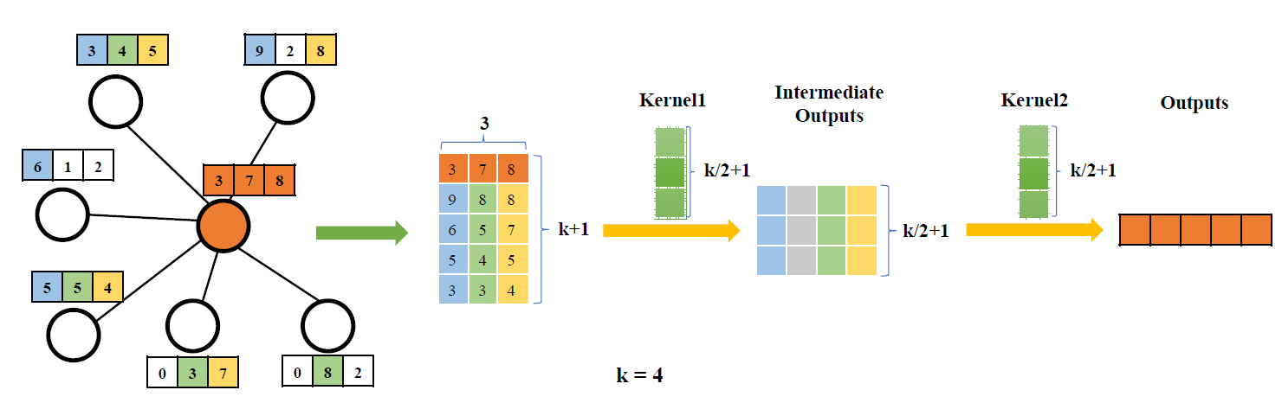
LGCL(A single layer)

Slide 28
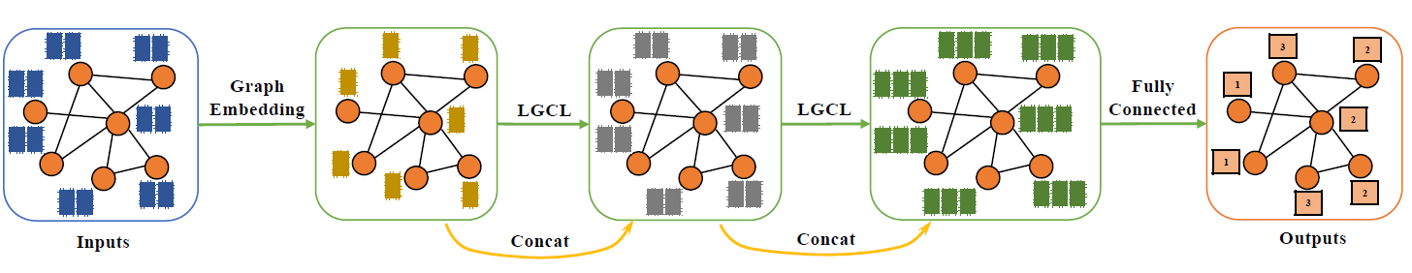
LGCN(Whole network)

Slide 29
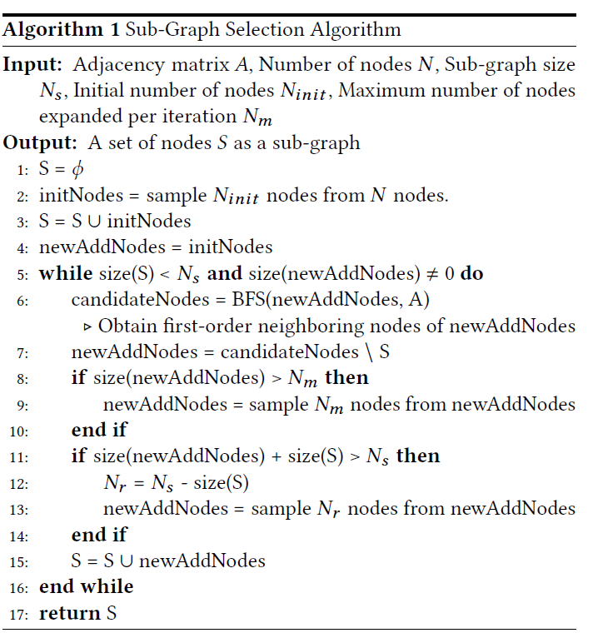
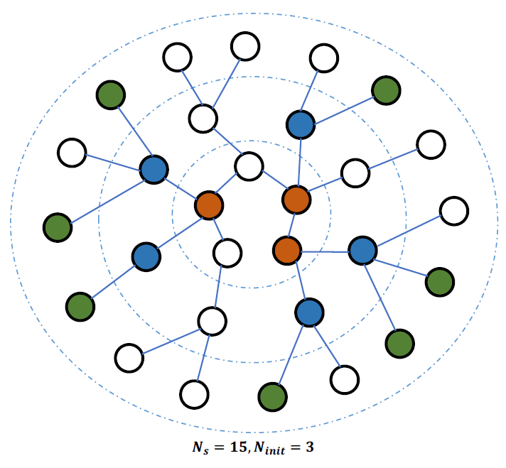
Sub-Graph Selection

Slide 30
GIN(Graph Isomorphism Network)
WL test: Weisfeiler-Lehman graph isomorphism test
aggregates the labels of nodes and their neighborhoods
hashes the aggregated labels into unique new labels
Conclusion: GNNs are at most as powerful as WL test
K. Xu, W. Hu, J. Leskovec, and S. Jegelka, “How powerful are graph neural networks?” in Proceedings of the 8th International Conference on Learning Representations, 2019.

Slide 31
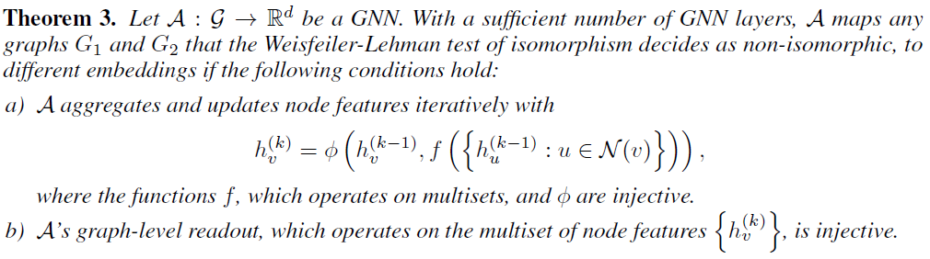
GIN

Slide 32

GIN

Slide 33

Experiments

Slide 34

Experiments

Slide 35
Modular GCN
GCNs are not universal function approximators due to permutation invariance
GIN assumes GCN with infinite number of hidden layers
Learning graph topology using graph moments
Nima Dehmamy, Albert-Laszlo Barabasi and Rose Yu, “Understanding the representation power of graph neural networks in learning graph topology” in 33rd Conference on Neural Information Processing Systems, 2019.

Slide 36



Graph moment
Graph moments encode topological information of a graph.
For instance, counts the number of paths from node i to j of length p.

Slide 37



Motivation

Slide 38

Theoretical analysis
Problem: Cannot learn

Slide 39


Modular GCN
Residual connection:

Slide 40




Deeper insights into GCN
Why GCNs work
Vertices in the same cluster tend to be densely connected
Laplacian smoothing
Why deep GCNs fail
Over-smoothing&Vanishing gradient
Computation
Validation set for model selection
Q. Li, Z. Han, and X.-M. Wu, “Deeper insights into graph convolutional networks for semi-supervised learning,” in Proceedings of the Thirty-Second AAAI Conference on Artificial Intelligence, 2018.

Slide 41

Theoretical analysis
Eigen-decomposition
Self-loop

Slide 42


Solutions
Co-Train a GCN with a Random Walk
GCN Self-Training

Slide 43


Experiments

Slide 44



DeepGCNs
Residual learning:
Dense connections:
Dilated aggregation: Dynamically changing neighbors to enlarge the receptive field and alleviate over-smoothing
GCN model:
Guohao Li, Matthias Muller, Ali Thabet, Bernard Ghanem, “DeepGCNs: Can GCNs Go as Deep as CNNs?” in the IEEE International Conference on Computer Vision (ICCV), 2019.

Slide 45


Dilated aggregation
Dilated k-NN returns the k nearest neighbors within the k*d neighborhood region by skipping every d neighbors. The nearest neighbors are determined based on a pre-defined distance metric. Experiments use the L2 distance in the feature space of the current layer.

Slide 46

Architecture

Slide 47

Experiments
mIoU: mean intersection over union TP/(FP+FN+TP) dataset: S3DIS

Slide 48

Experiments

Slide 49
References
[1]W. Hamilton, Z. Ying, and J. Leskovec, “Inductive representation learning on large graphs,” in NeurIPS, 2017.
[2]J. Chen, T. Ma, and C. Xiao, “Fastgcn: fast learning with graph convolutional networks via importance sampling,” in Proceedings of the 7th International Conference on Learning Representations, 2018.
[3]J. Chen, J. Zhu, and L. Song, “Stochastic training of graph convolutional networks with variance reduction,” in International Conference on Machine Learning, 2018.
[4]M. Niepert, M. Ahmed, and K. Kutzkov, “Learning convolutional neural networks for graphs,” in International Conference on Machine Learning, 2016.
[5]H. Gao, Z. Wang, and S. Ji, “Large-scale learnable graph convolutional networks,” in Proceedings of the 24th ACM SIGKDD International Conference on Knowledge Discovery &amp; Data Mining, 2018.

Slide 50
References
[6] K. Xu, W. Hu, J. Leskovec, and S. Jegelka, “How powerful are graph neural networks?” in Proceedings of the 8th International Conference on Learning Representations, 2019.
[7] Nima Dehmamy, Albert-Laszlo Barabasi and Rose Yu, “Understanding the representation power of graph neural networks in learning graph topology” in 33rd Conference on Neural Information Processing Systems, 2019.
[8] Q. Li, Z. Han, and X.-M. Wu, “Deeper insights into graph convolutional networks for semi-supervised learning,” in Proceedings of the Thirty-Second AAAI Conference on Artificial Intelligence, 2018.
[9] Guohao Li, Matthias Muller, Ali Thabet, Bernard Ghanem, “DeepGCNs: Can GCNs Go as Deep as CNNs?” in the IEEE International Conference on Computer Vision (ICCV), 2019.

